Slide 1






Optimizing Inventory Management of Sufal Bangla,Satlake
Gaurav Ginodia
22f3002972@ds.study.iitm.ac.in

Slide 2

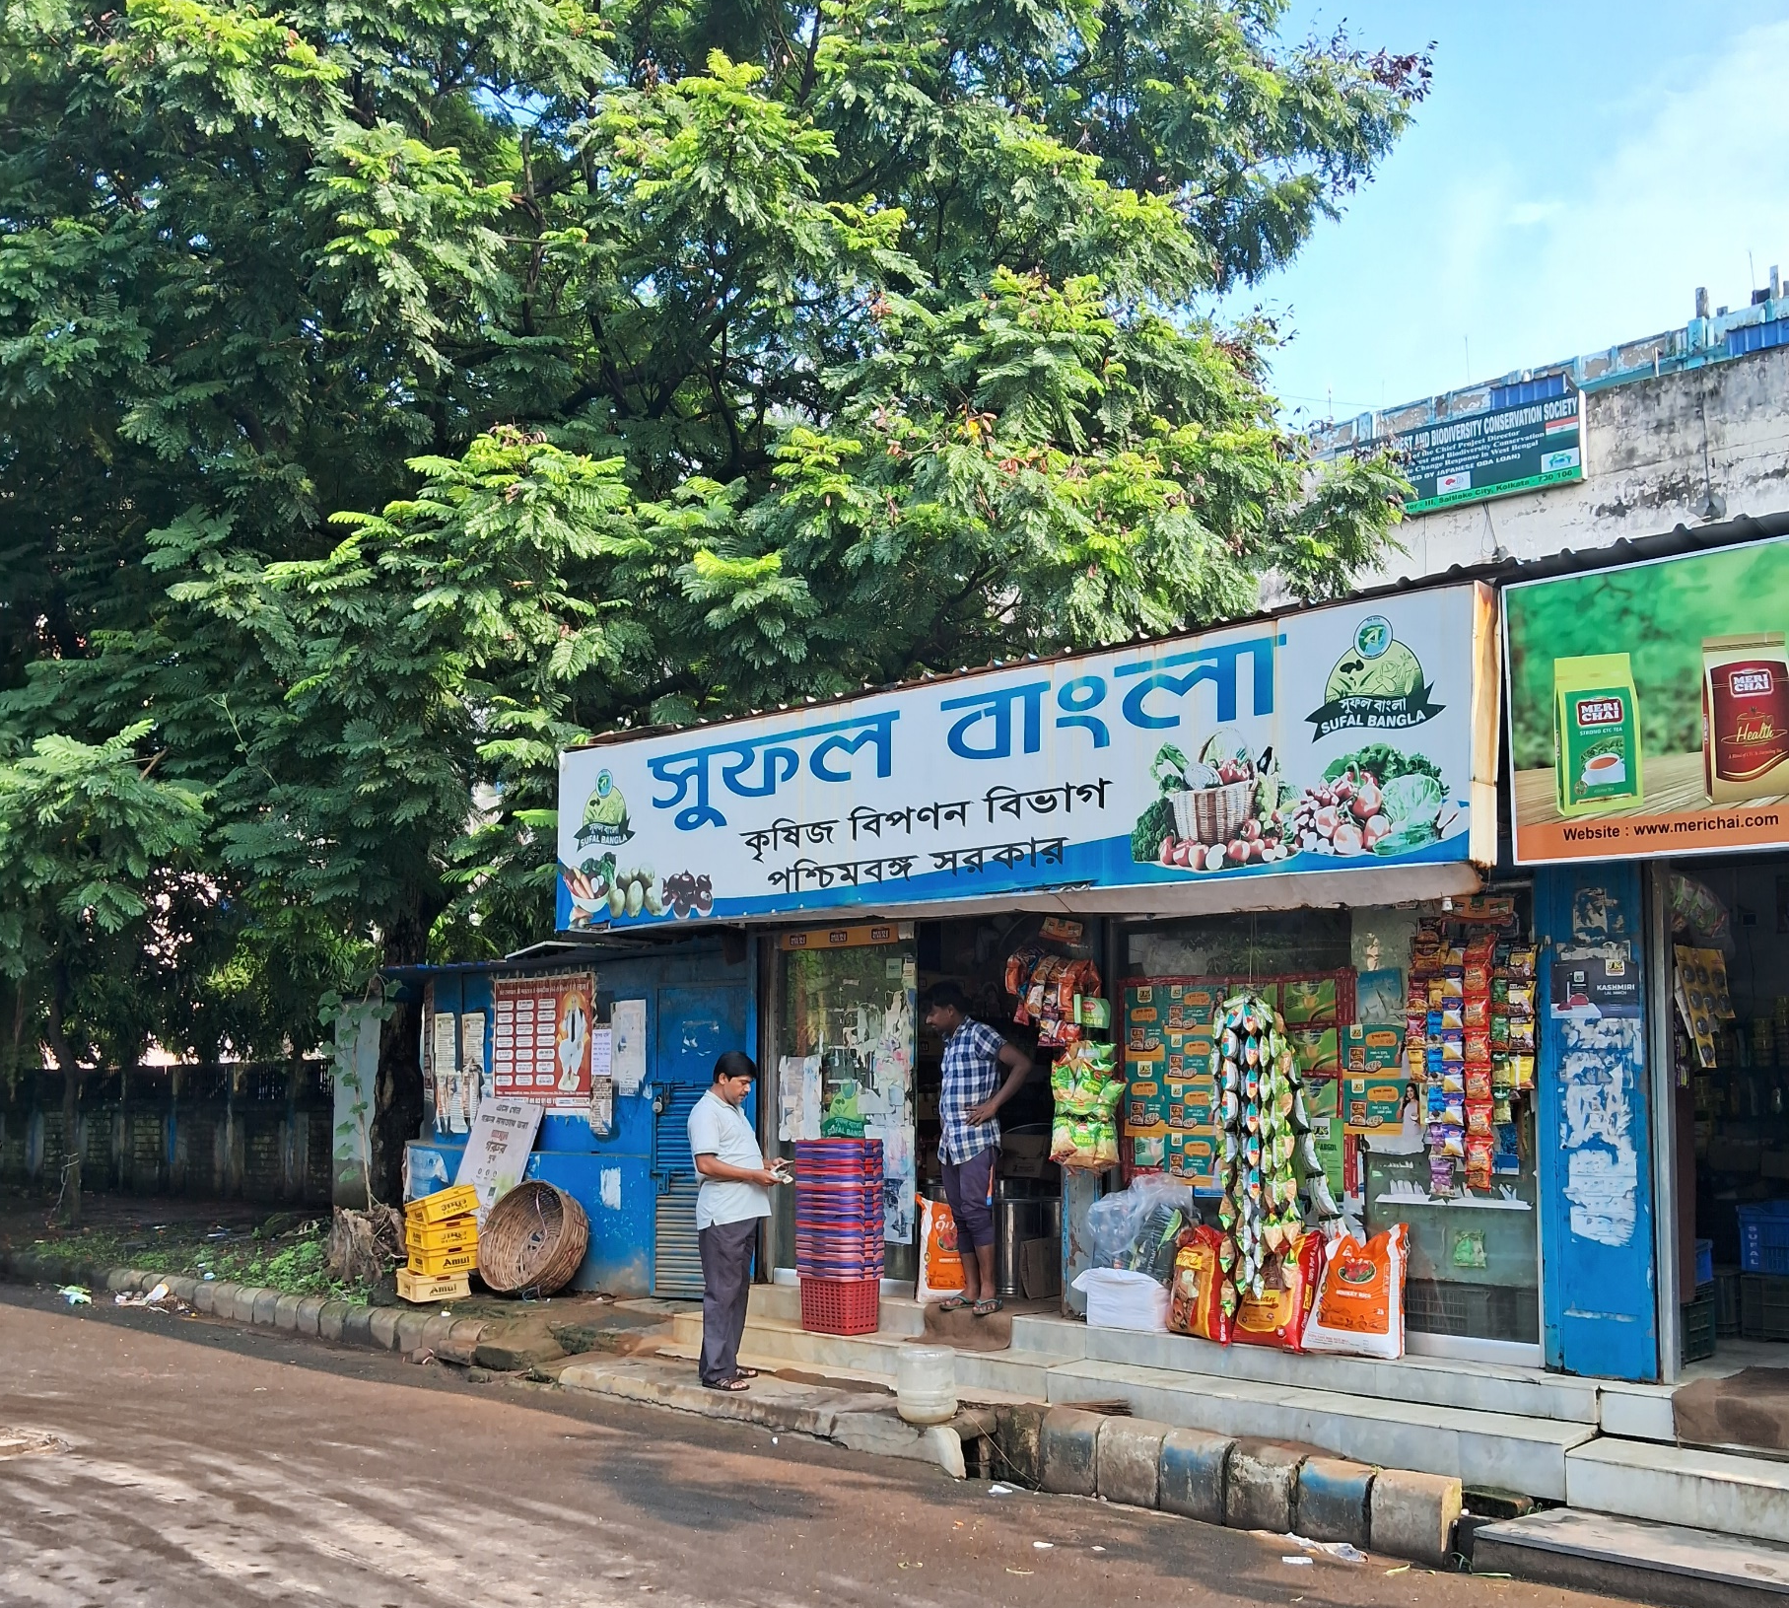
ABOUT THE BUSINESS
Sufal Bangla ,Saltlake is a government initiated franchise of Sufal Bangla,privately owned by Mr. Sourashis Das.
It is a B2C business,which sells almost every grocery item,but focuses majorly on fresh vegetables.
Located in the Saltlake-Sector III, the business wants me to optimize their vegetable inventory to prevent wastage of vegetables.

Slide 3
CHALLENGES
It faces a significant challenge with the spoilage of fresh vegetables, leading to considerable waste and financial losses
It is encountering intense competition from online platforms like Blinkit and BigBasket.
Wants to expand the business,but lacks funds.

Slide 4
DATA
OVERVIEW
Following data was collected from the period May,2024 to July, 2024
01.
02.
Monthly Data
Name of the Vegetable
May Sales
June Sales
July Sales
03.
Sale Data
Name of the Vegetable
Unit
Average Rate(INR)
Sale of Week1-12
Purchase Data
Name of the Vegetable
Unit
Average Selling Price
Total Sale
Avg Purchase Price(Rs)

Slide 5
METHODOLOGY
Data Collection:Sales and revenue data were systematically collected for each vegetable over a 12-week period.
Descriptive Analysis:Key statistics were computed, including:Total sales,Maximum and minimum weekly sales,Total revenue,Total Profit,Wastage percentage.
Pareto Analysis:Conducted to identify the vegetables contributing most significantly to total sales and revenue, highlighting the top-performing items (Revenue pareto,Sales Pareto).
Wastage Calculation:Analyzed vegetables with an average shelf life of 7 days or less to determine:Percentage of wastageImpact of wastage on profit
Customer Survey:Surveyed customers to assess their preferences between offline and online shopping channels.

Slide 6
Results & Findings
Top five Performers (Revenue): Green chili, Sweet Corn, and Potato-Chandramukhi are the top three vegetables in terms of revenue generation.
Top five Performers (Sales): Potato-Chandramukhi and Lime have the highest sales, indicating their popularity.

Slide 7
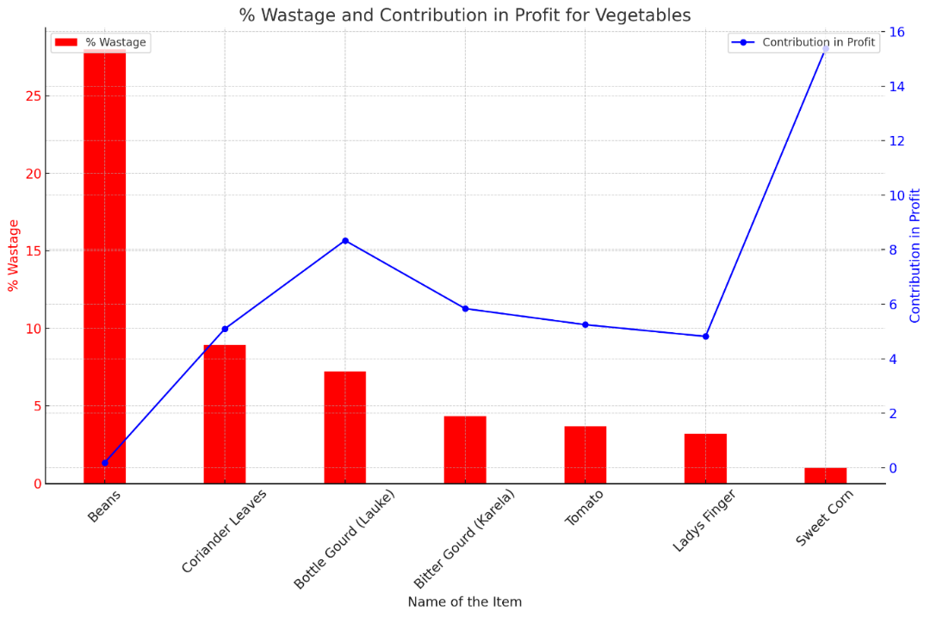
Results & Findings
Shelf Life Data and Wastage Findings : Beans with most wastage contributes lowest to the profits.

Slide 8
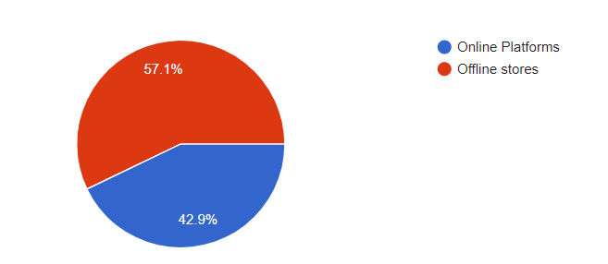
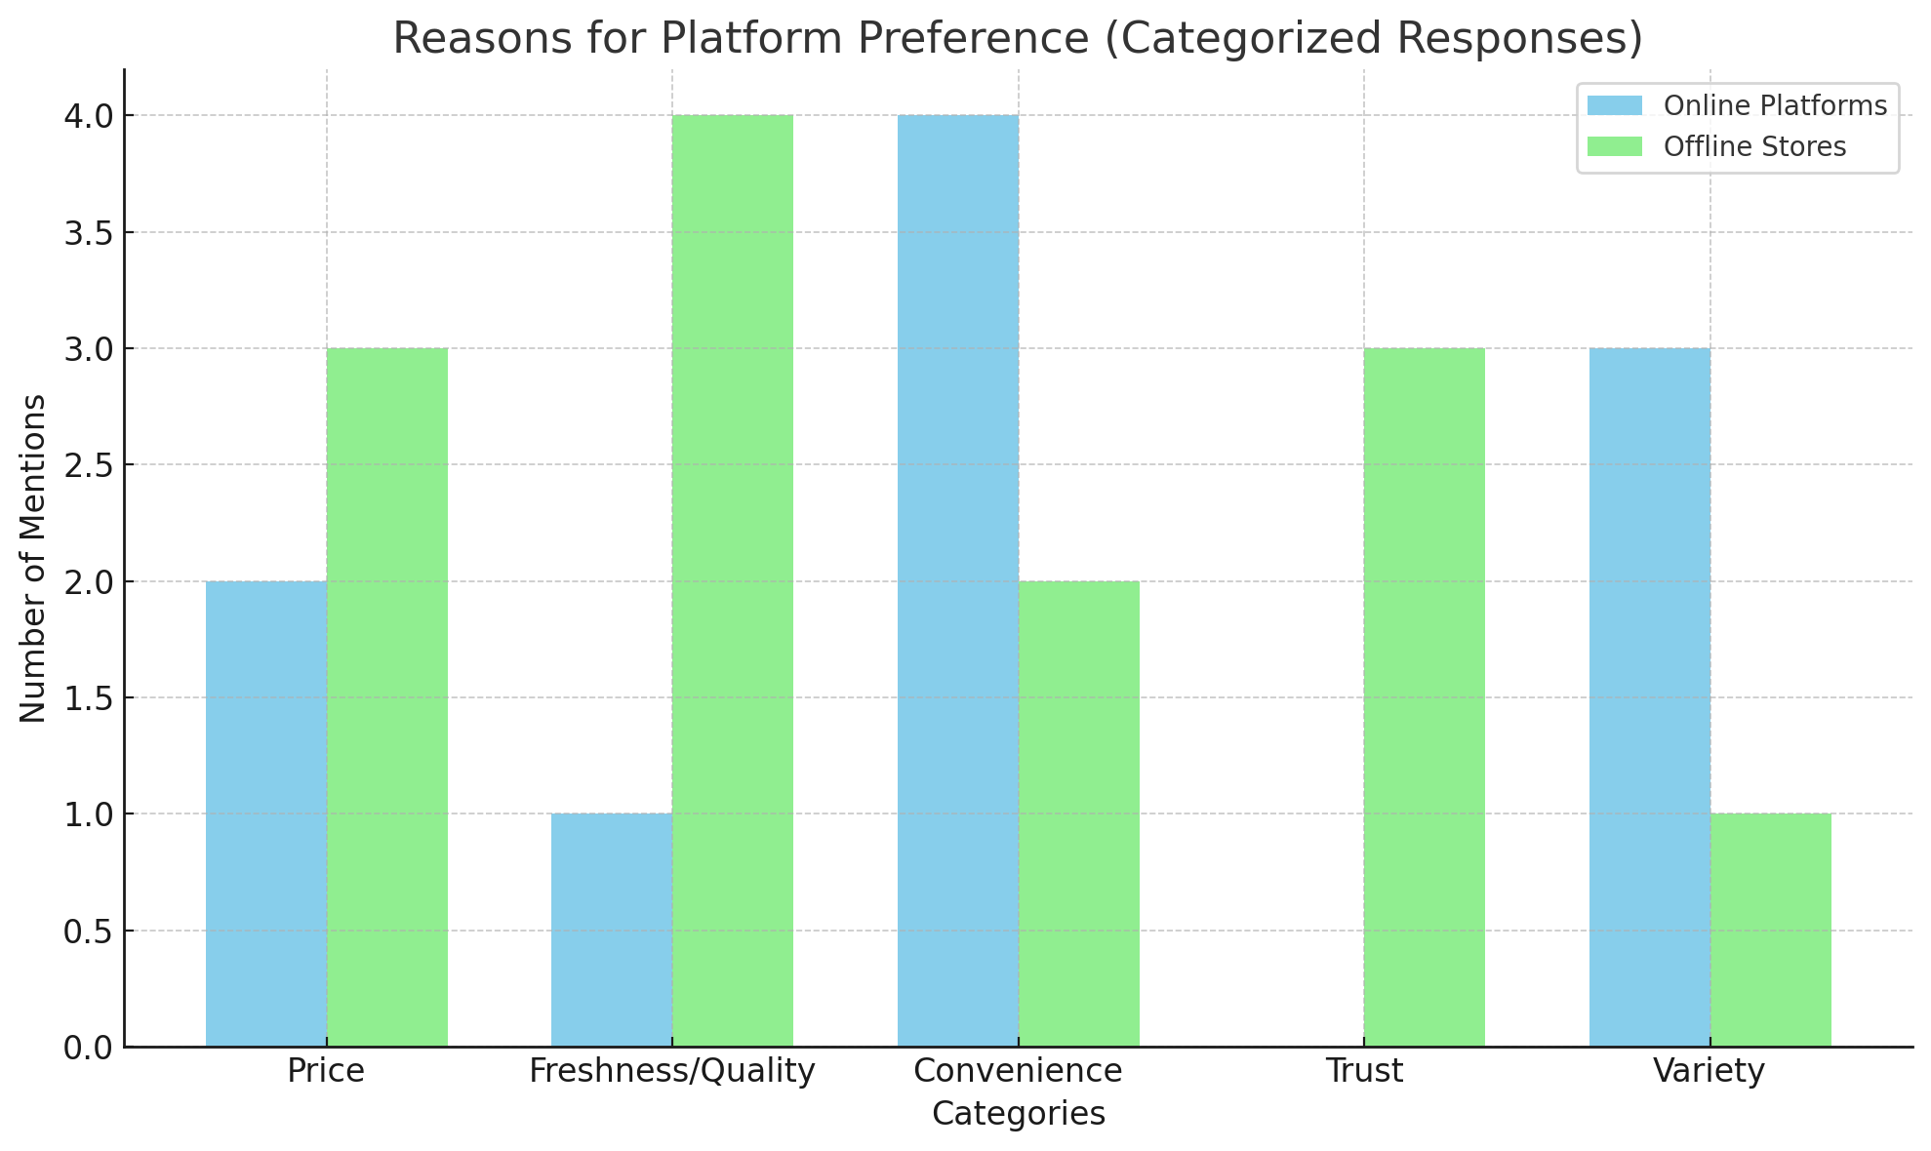
Results & Findings
Customer Preferences: Offline mode was more trusted,but online also made up 42.9% of the total responses collected via the survey form.
Reason for their preference: Online was preferred mostly for convenience, and variety.
Total Responses:14

Slide 9
RECOMMENDATIONS
Prioritize Inventory Management for High-Revenue Vegetables: Focus on maintaining optimal stock levels of Green Chili, Sweet Corn, and Potato-Chandramukhi. This strategy will help prevent stockouts, maximize revenue potential, and ensure that customer demand is consistently met.
Revenue Enhancement: For vegetables with high sales volumes, such as Potato-Jyoti and Lime, review and adjust pricing strategies to increase revenue per unit.
Expand Market Presence for High-Demand, Low-Wastage Vegetables: For Green Chili and Sweet Corn, which show strong demand and minimal wastage, focus on broadening their market reach. Increase distribution channels, boost product visibility, and explore new market segments to promote their profitability and drive growth.
Wastage Reduction through Strategic Promotions : Implement targeted promotional campaigns to better manage high-wastage items. By aligning promotions with inventory levels and adjusting prices based on demand, business can reduce waste, minimize losses, and enhance overall profitability.
Introduce Premium Cut-Vegetable Options: Offer higher-priced cut vegetable options in offline stores to attract customers who value convenience and quality. This can enhance customer satisfaction and increase sales and revenue.
Expand Home Delivery Services: Develop or enhance home delivery services to nearby residential complexes. Catering to customers who prefer fresh produce delivered to their doorstep can drive sales growth and meet increasing demand for convenience.
By strategically managing inventory, optimizing pricing, and expanding market presence, you can effectively enhance revenue and reduce wastage. Emphasizing convenience through premium cut-vegetable options and expanded home delivery services will further drive growth and customer satisfaction. Implementing these recommendations will position your business for sustained success and increased profitability.

Slide 10
THANK YOU !!

